Slide 1
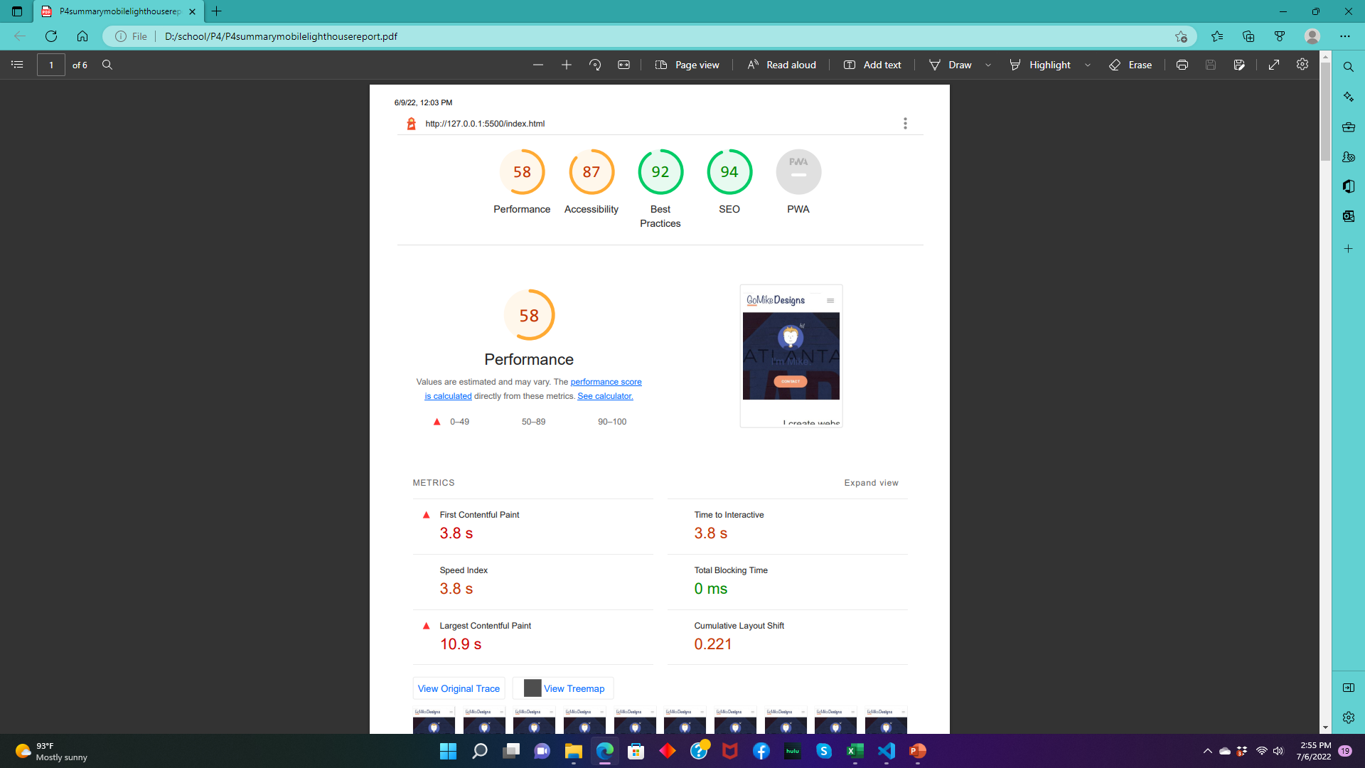
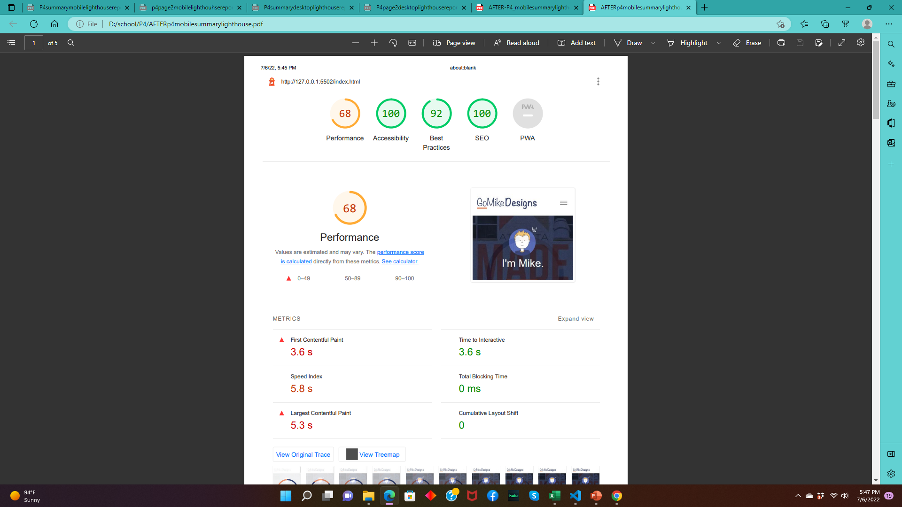
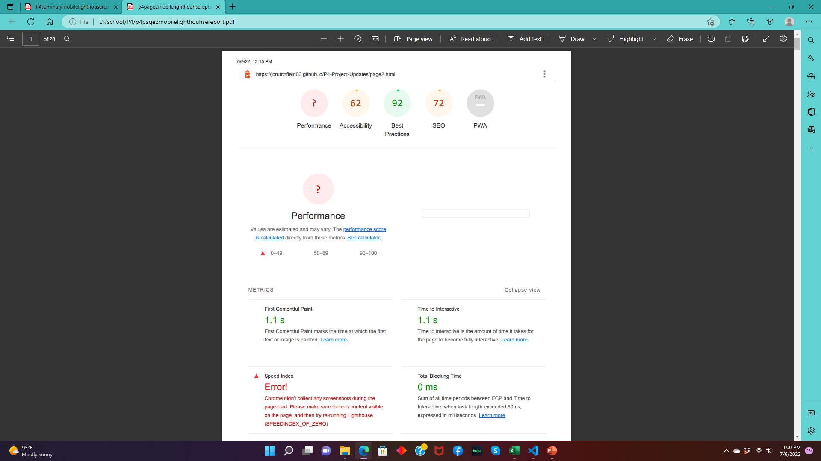
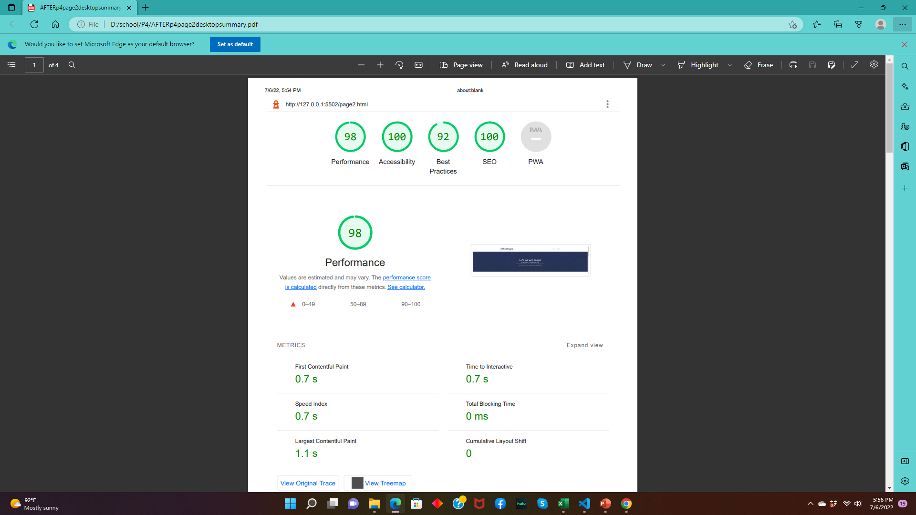
Mobile
BEFORE
AFTER
Page 1
Page 1
Page 2
Page 2

Slide 2
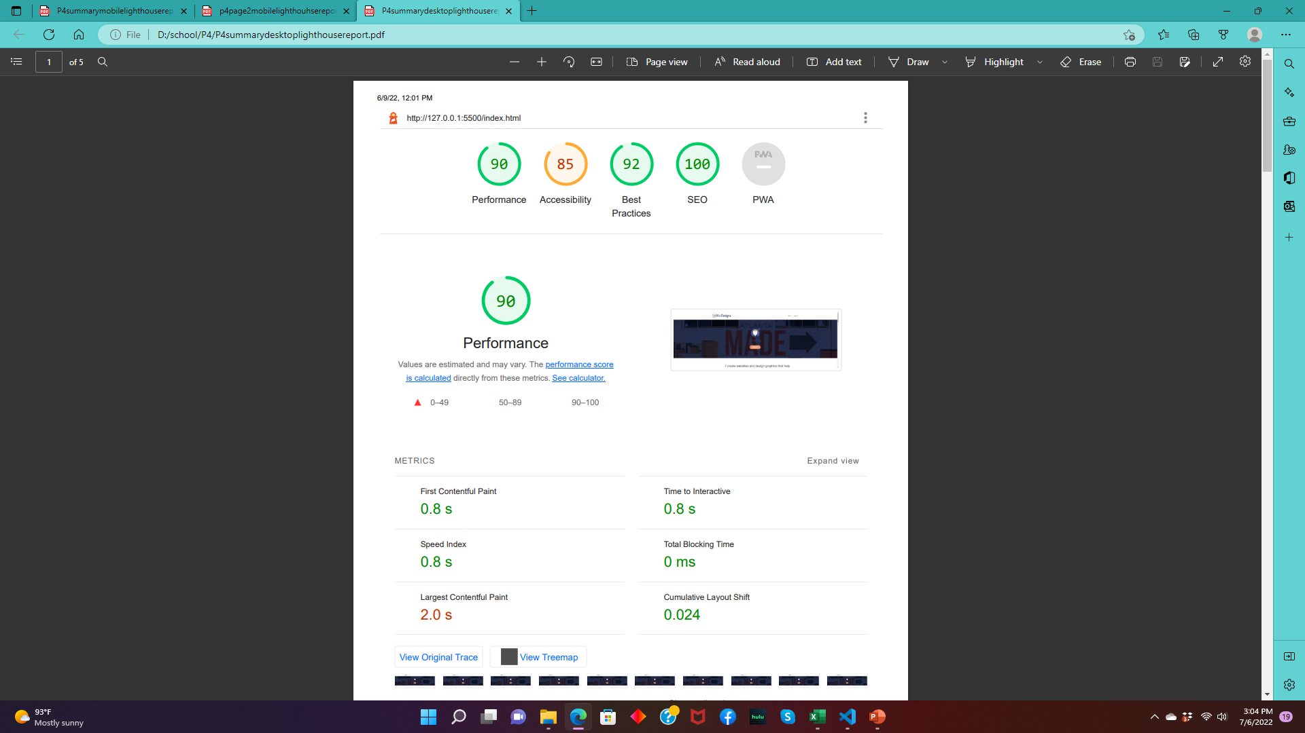
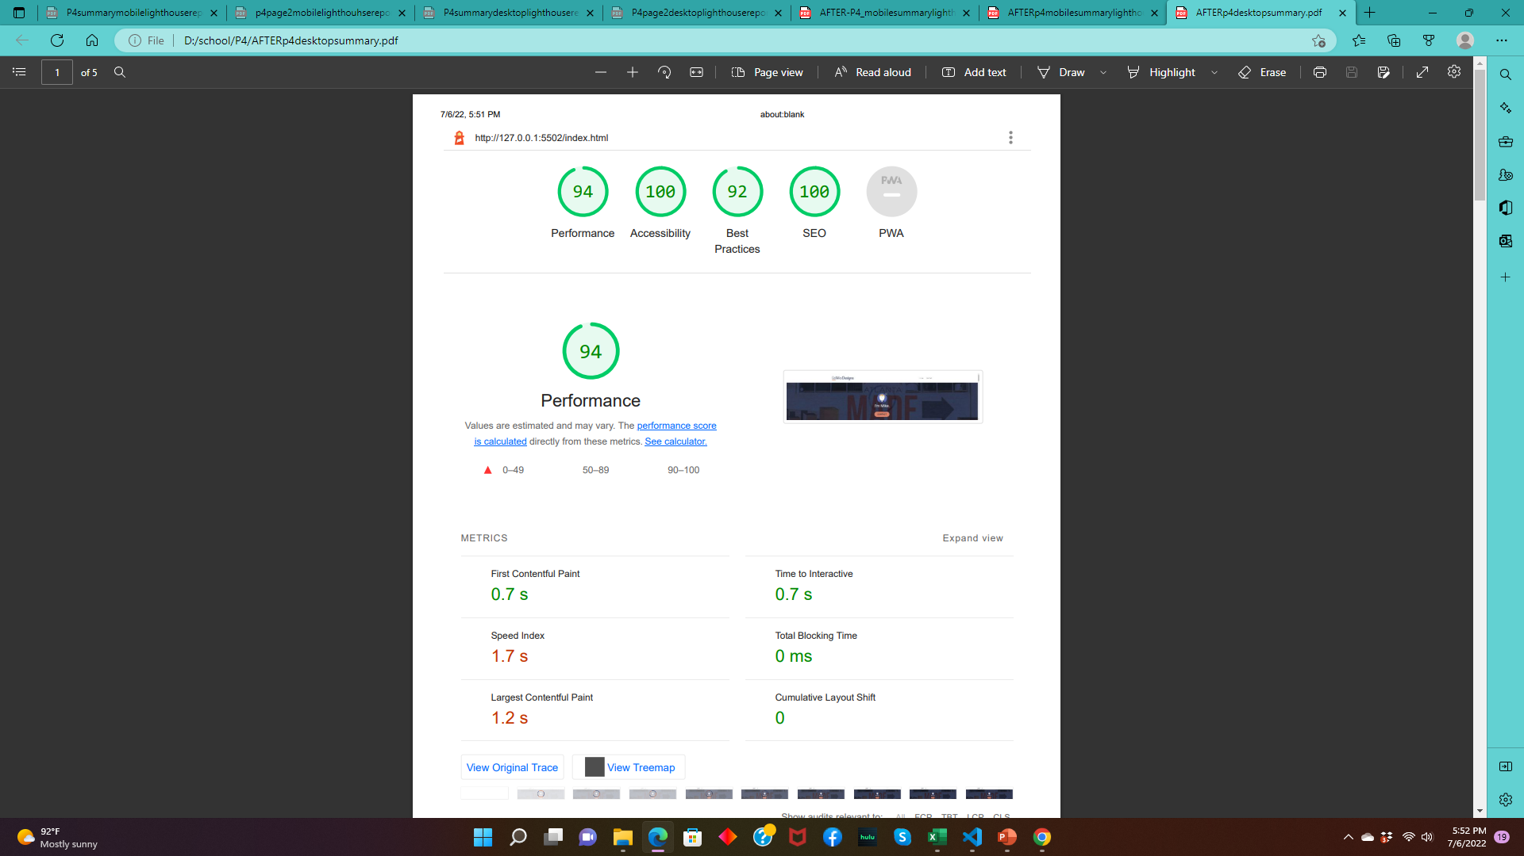
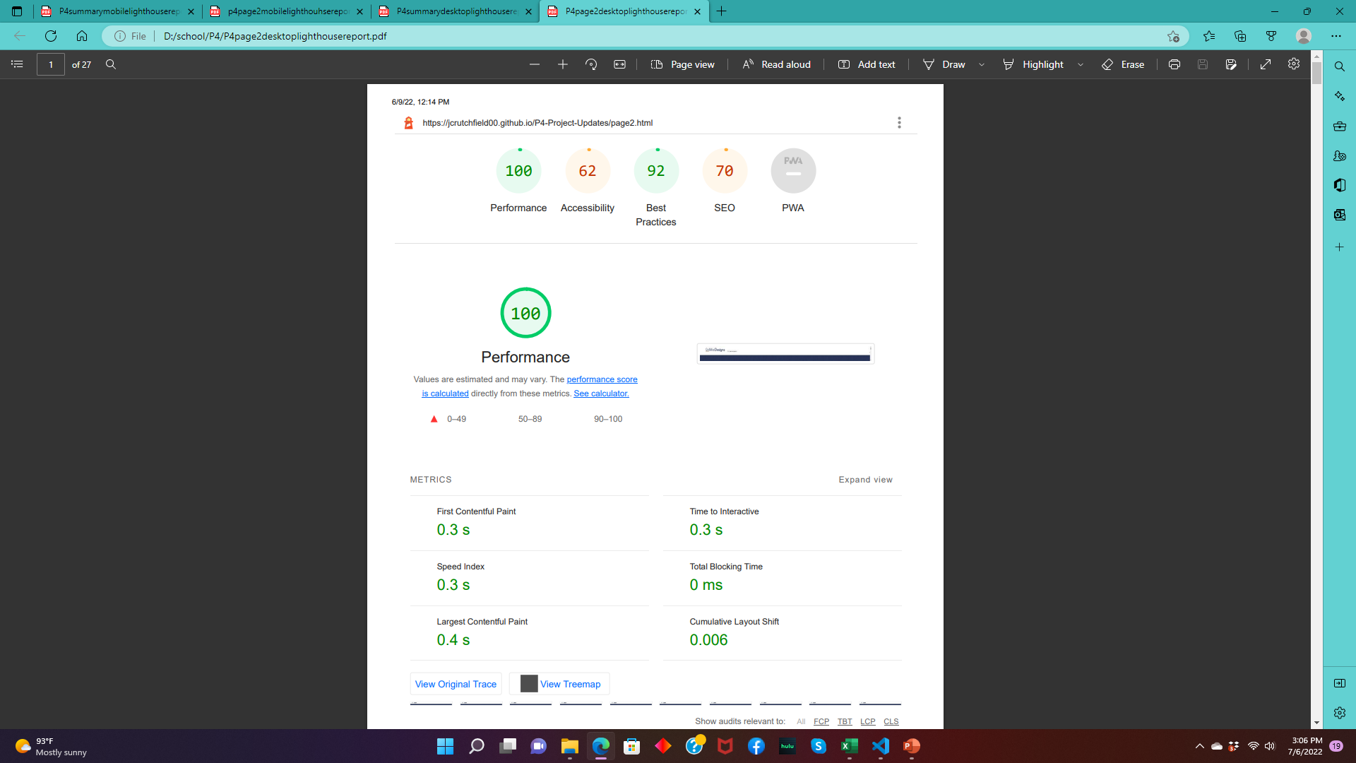
Desktop
BEFORE
AFTER
Page 1
Page 1
Page 2
Page 2

Slide 3
Powermapper
Before
After

Slide 4
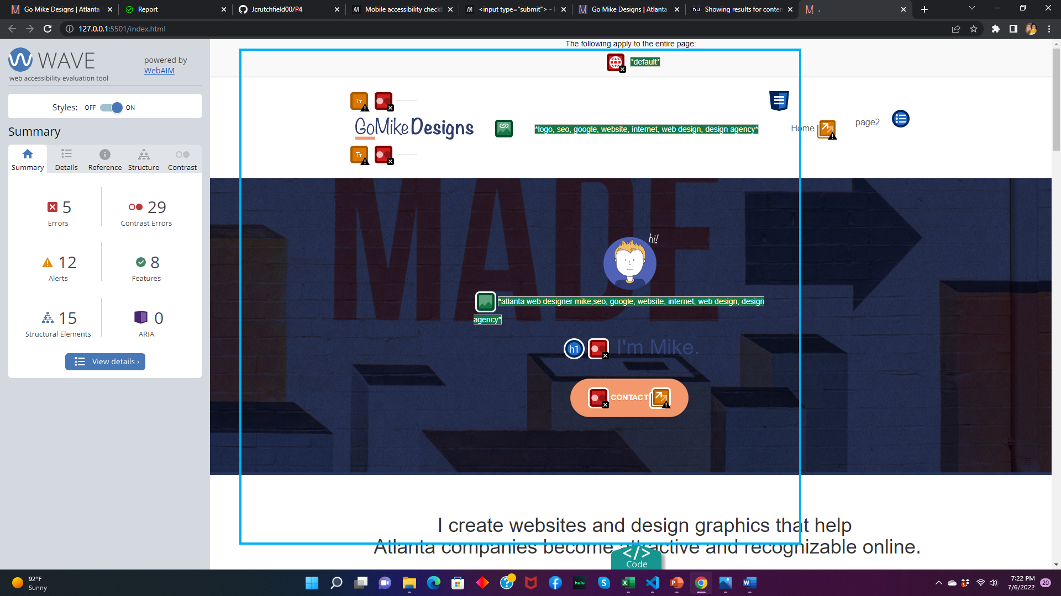
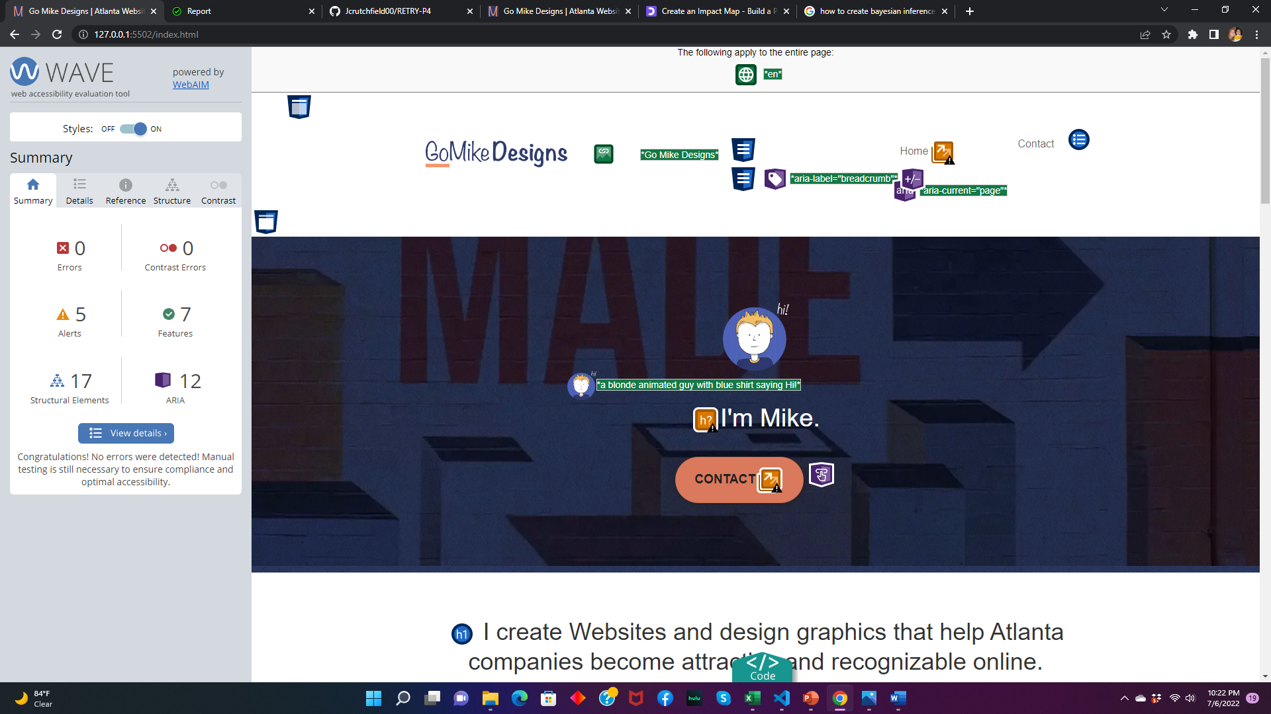
WAVE-page1
BEFORE
AFTER

Slide 5
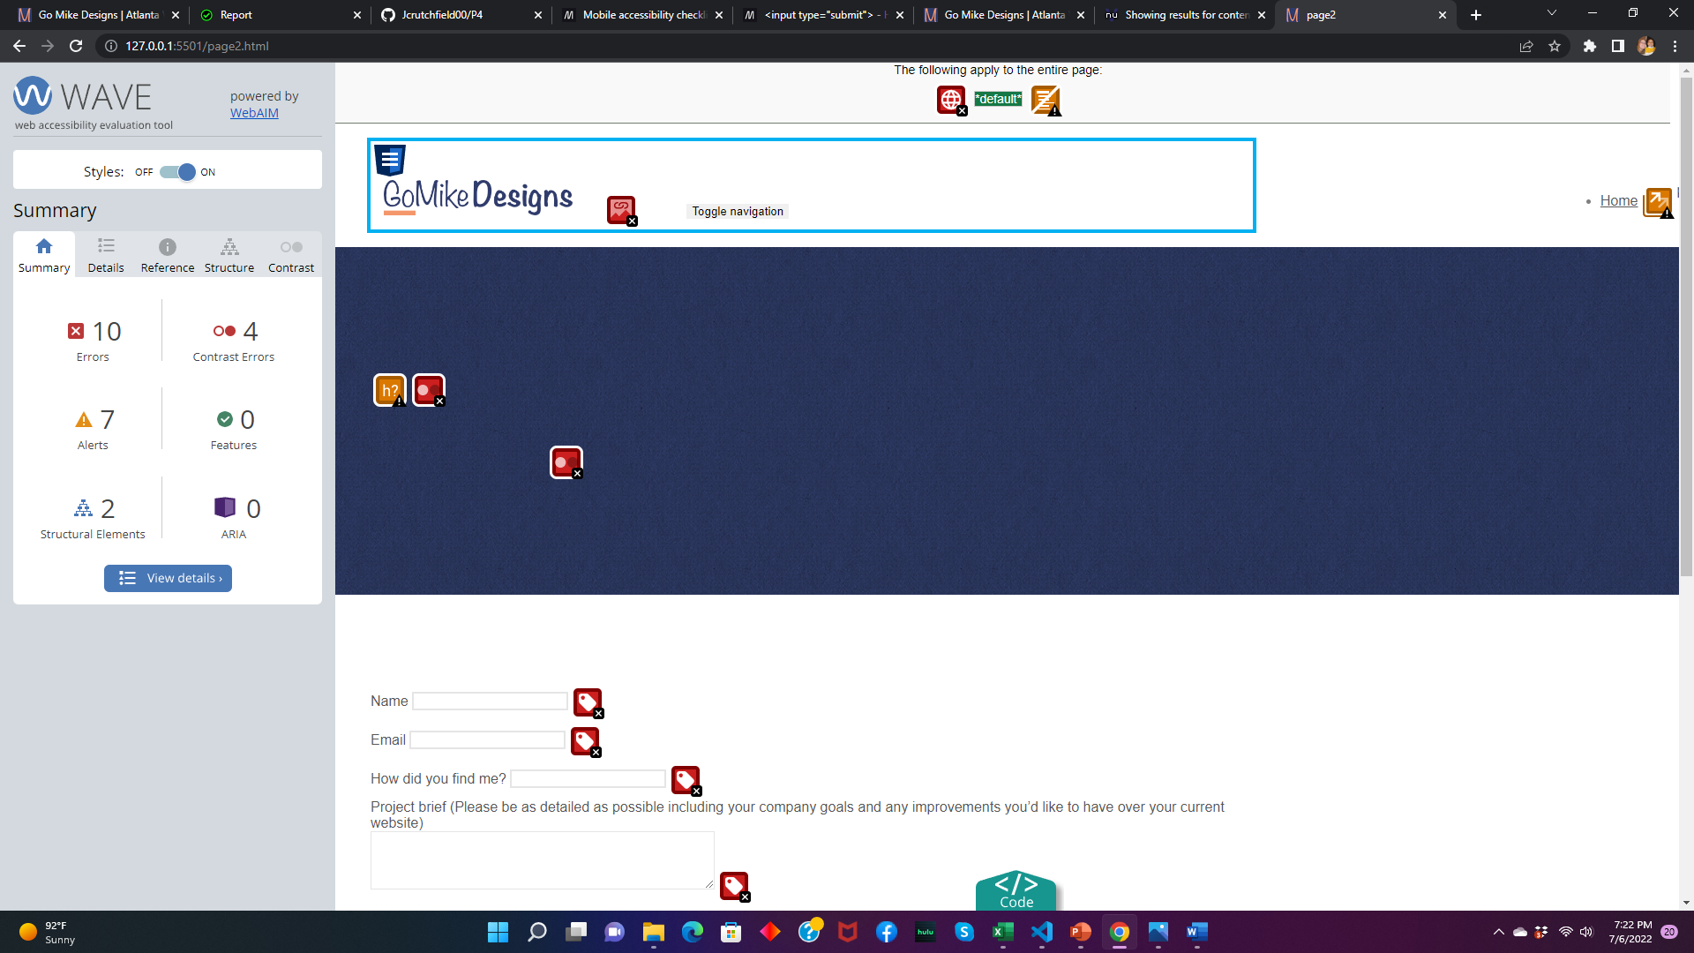
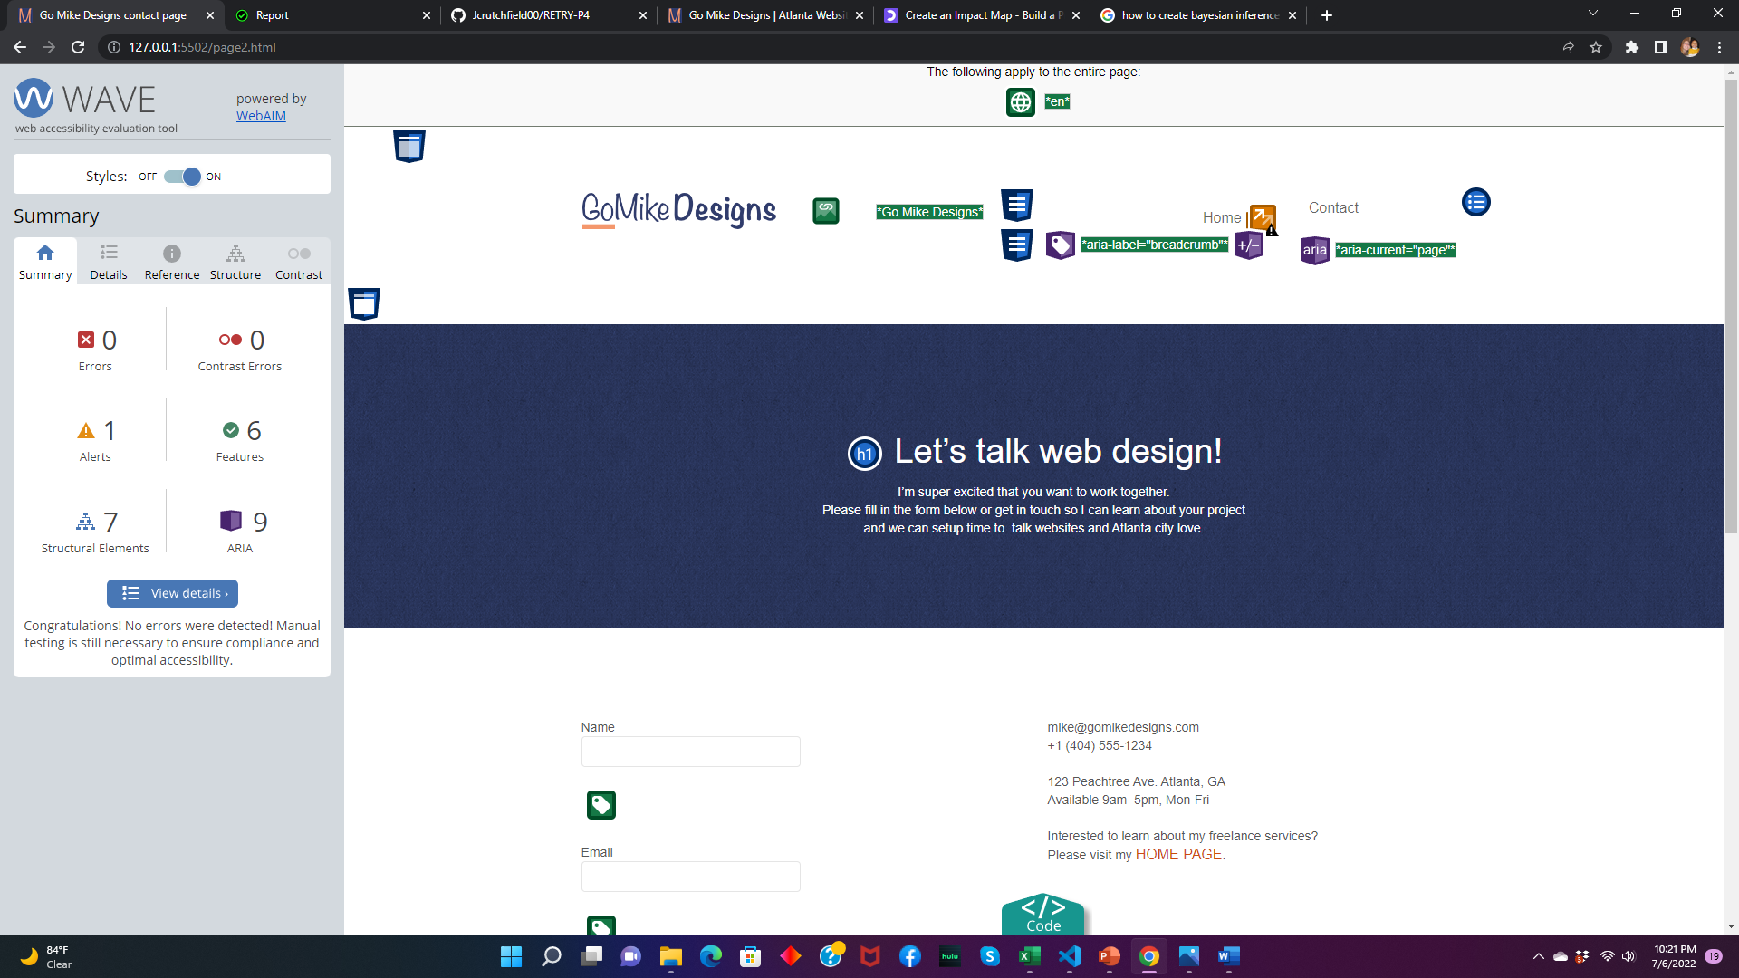
Wave-page2
BEFORE
AFTER

Slide 6
Page 1
DESKTOP
MOBILE
SEO and Accessibility both at 100 on all pages and across devices according to lighthouse audit

Slide 7
Page 2
Desktop
Mobile
SEO and Accessibility both at 100 on all pages and across devices
according to lighthouse audit

Slide 8
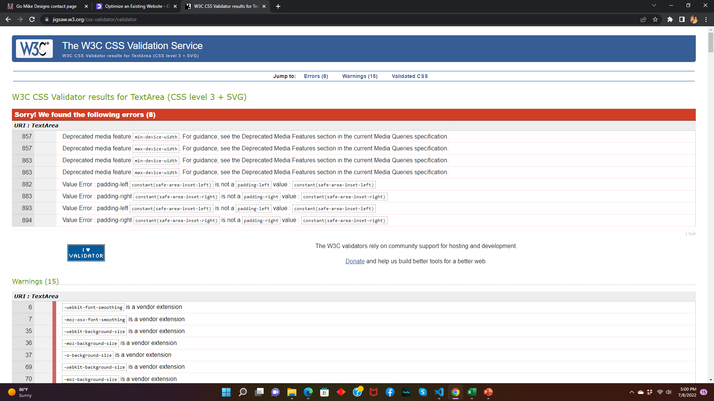
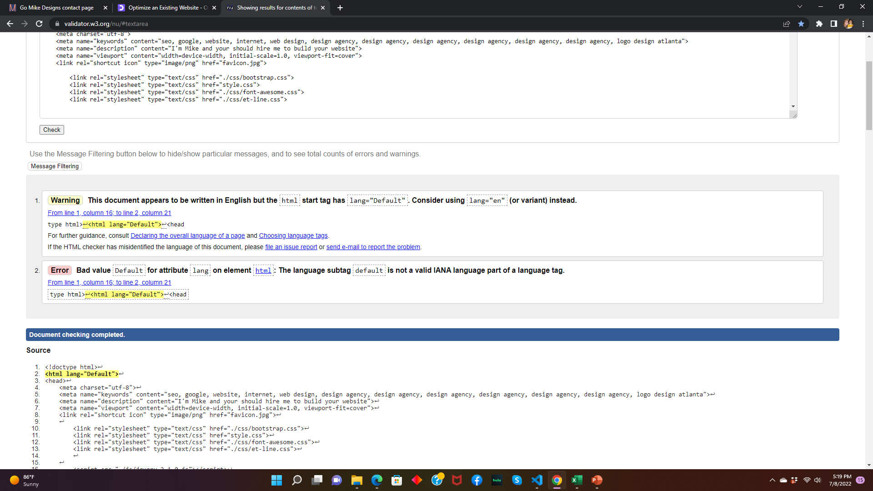
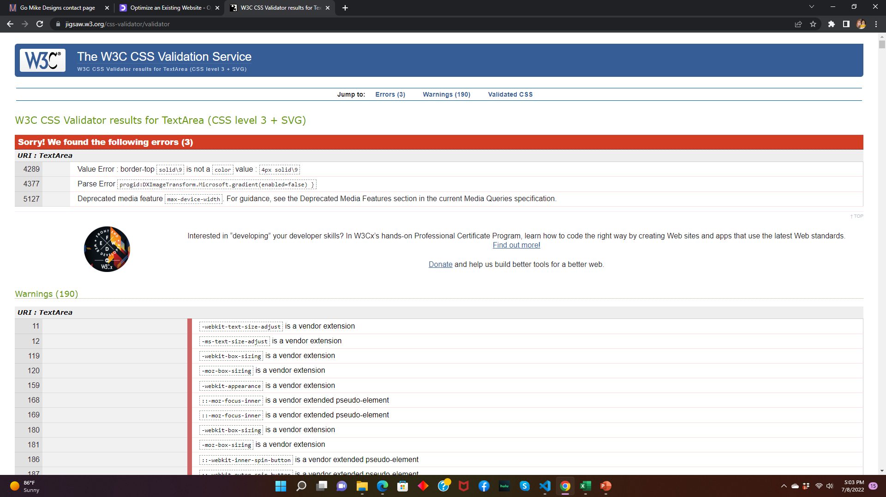
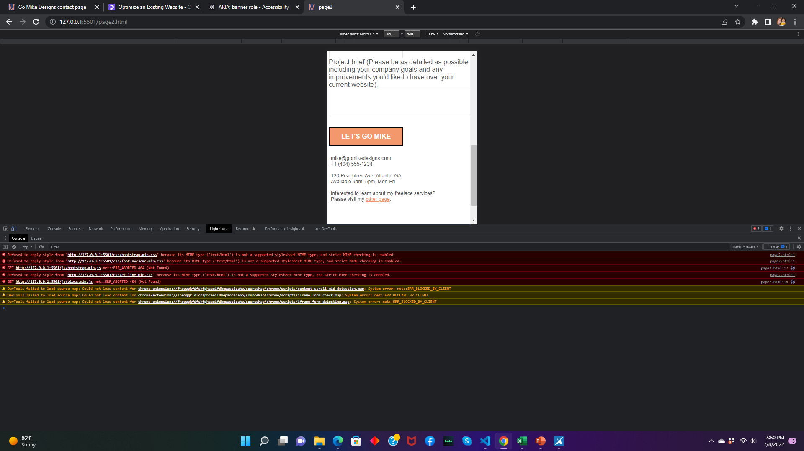
Errors
Several broken links in footer as well as in bootstrap.css(powermapper)
CSS wasn’t error free
HTML had errors
Console had errors
Style.css
HTML
Bootstrap.css

Slide 9
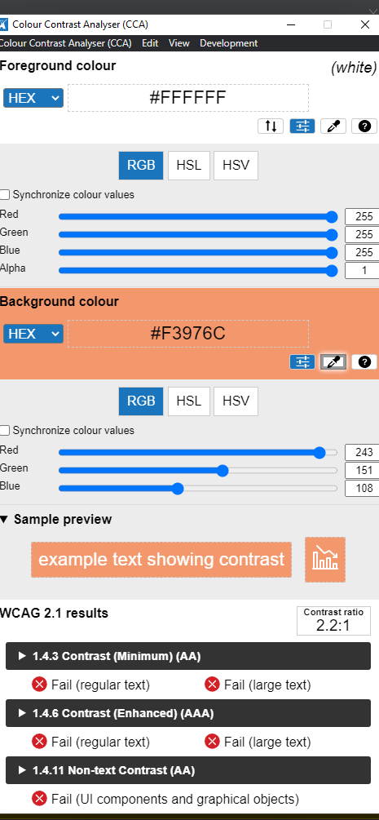
Accessibility increased on all pages, mobile, and desktop to 100!
With these changes:
Img elements did not have alt attributes
Added alt “misc. desc…” to all imgs
Form elements did not have associated labels
Placed <input> inside the <label>
Links did not have a discernible name
Added alt to logo
Added aria-label to icons
Color contrast issue on button and a link
Changed the color orange to a shade darker to help meet the contrast ratio
Increased the size of text
Also changed button text to black
Changed the dark blue and gray text to white to increase contrast ratio and have visible text
Lang attribute “default” wasn’t valid
Changed it to “en”

Slide 10
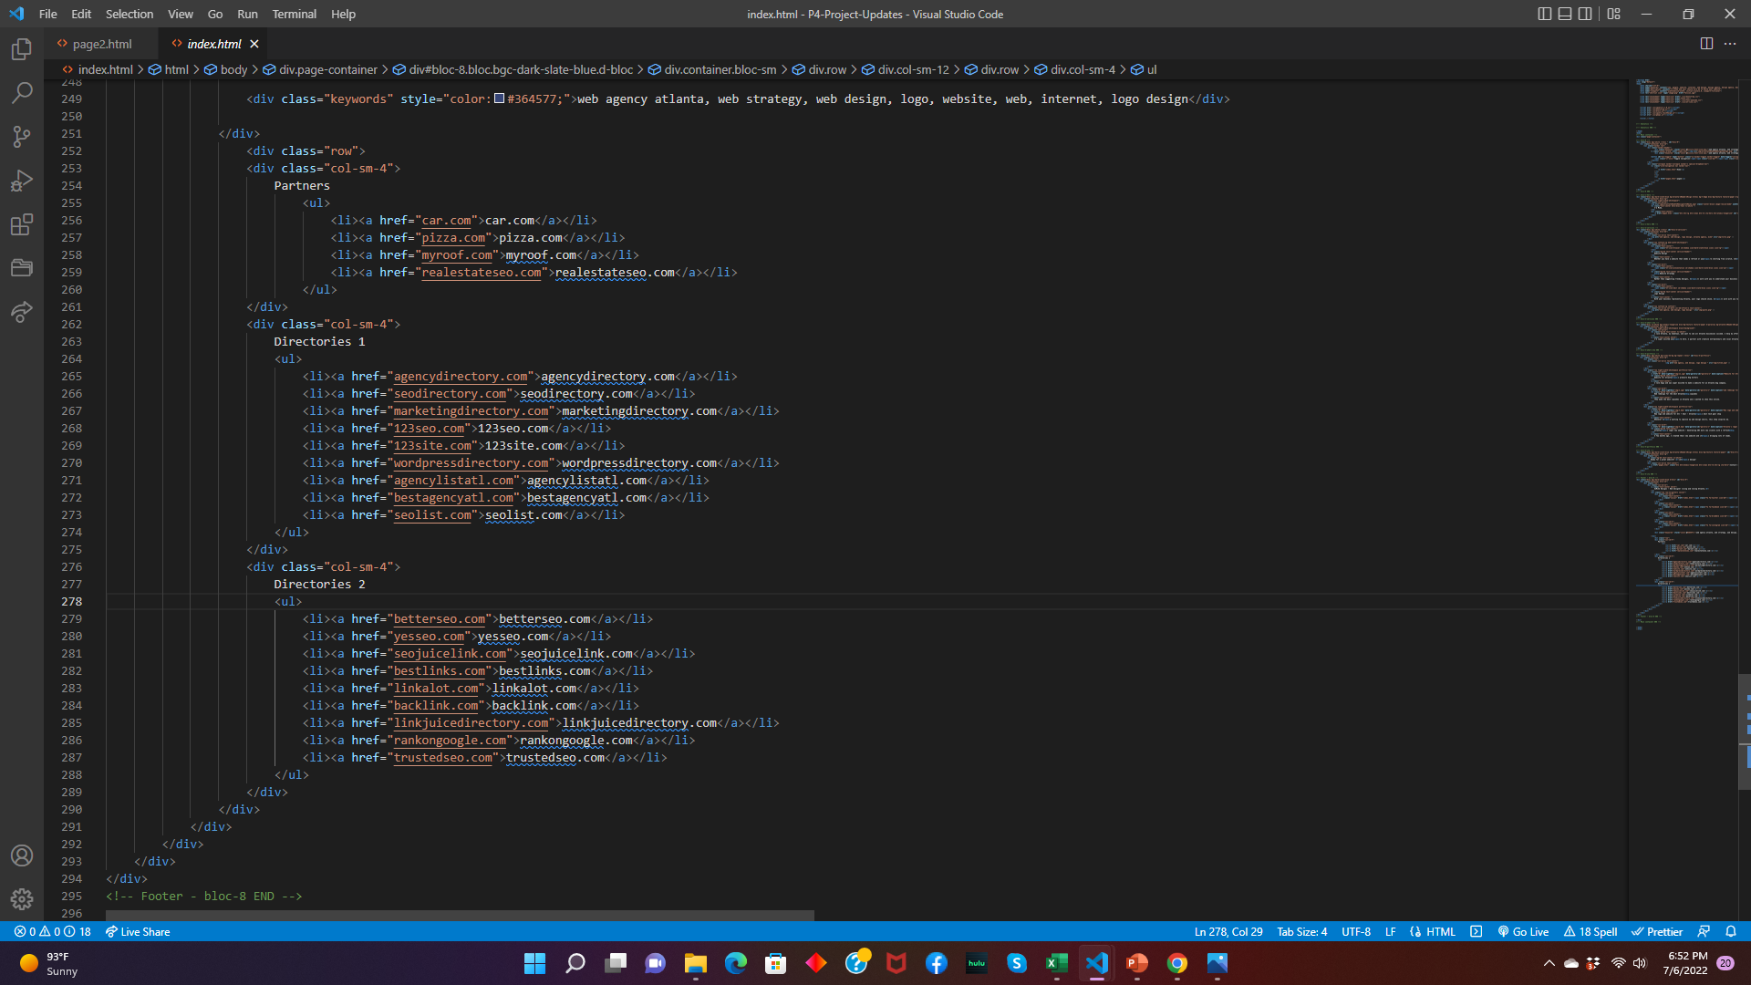
SEO increased on all pages, mobile, and desktop to 100!
Tap targets weren’t sized appropriately
Deleted all unnecessary links in footer
Changed font-sizes to makes larger and easier to read and tap
Meta description empty
Added content “misc.”
Images don’t have alt attributes
Added alt “misc. desc..”
Black hat keywords in alt “misc. keywords”
Deleted and replaced with proper alt desc.
Links aren’t crawable
Deleted onclick scroll to top(I don’t know anything about onclick)
Replaced with a CSS version of the scroll to top

Slide 11
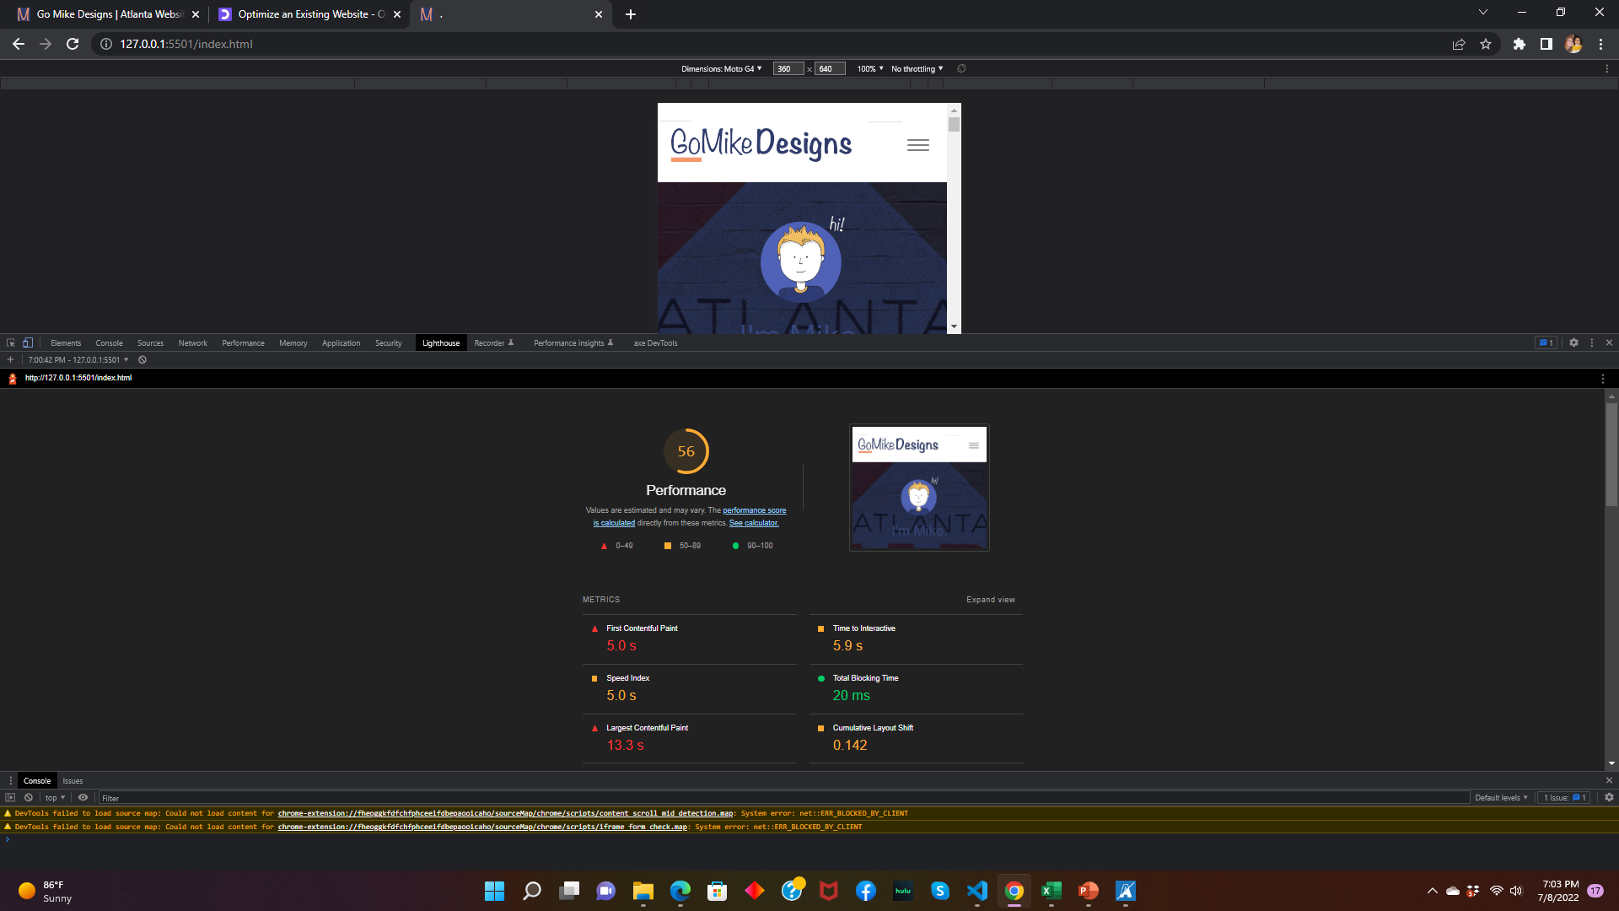
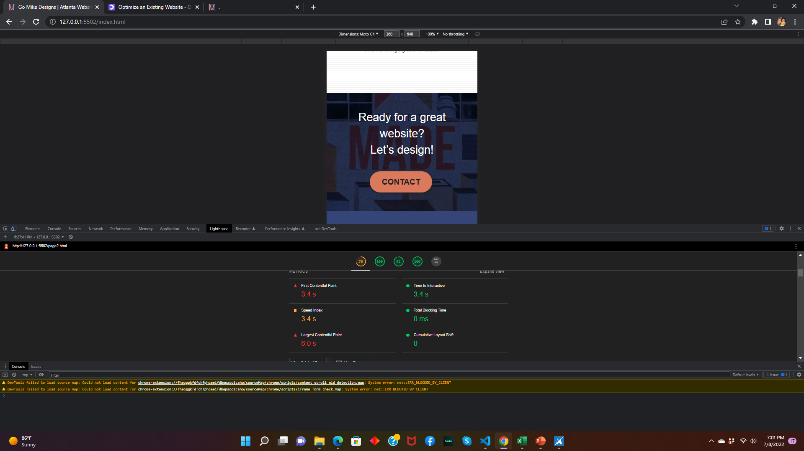
Performance increased slightly
Serve images in next-gen formats
Converted images to avif and webp
Some web browsers don’t recognize next-gen, so I placed them in a <picture> with a secondary image a compressed jpg
Efficiently encode images
Used Squoosh to decrease the image size to usable size
Compressed the images
Properly size images
Added width and height to all images in HTML
Eliminate Rendor Blocking resources
Used defer in <head>
Used preload in <head>
Used CDN files in <head>
Enable text compression
Minified most CSS and JS files

